Slide 1
Gravitational Waves
Sam Grobelny, Sacha Wible, Wentao Zhong

Slide 2
Motivations
Methods + Assumptions
By studying black hole mergers via gravitational waves, we can figure out the distance from Earth. Comparing this to redshift of the light from these events allows us to better understand the universe's expansion.
By using gravitational wave data collected from LIGO we should be able to calculate the masses of the two black holes that merged in order to cause the wave.
Chirp Mass = (c^3 * peak frequency)/ (pi * G)

Slide 3
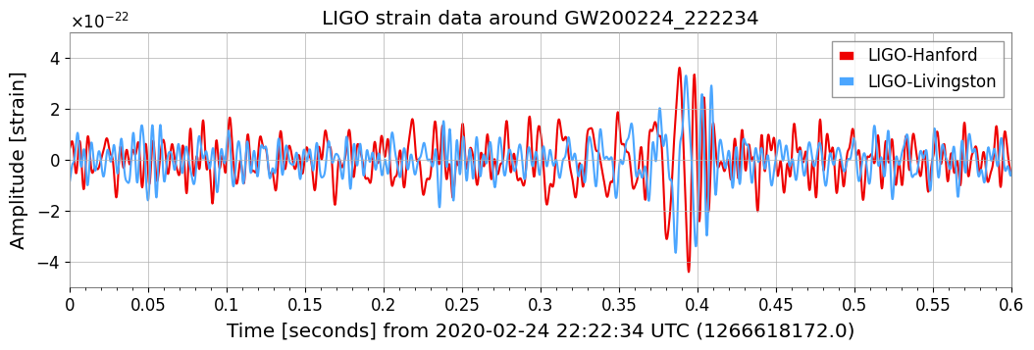
Notes:
Strain is the change in distance caused by the gravitational wave

Slide 4
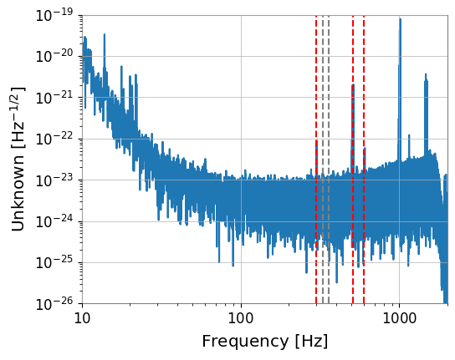
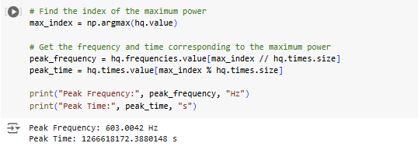
Fast Fourier transform - GW200224_222234
Notes:
By transforming the data into a frequency domain, its easier to tell which frequencies dominate the sample and how they vary over time, as well as improving the Signal to Noise ratio

Slide 5
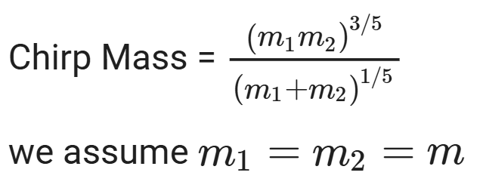
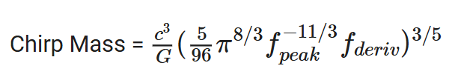
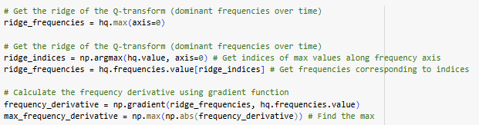
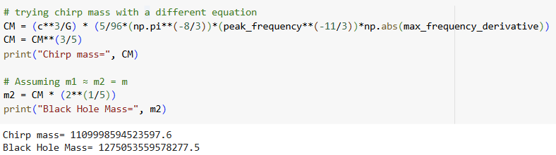
Chirp Mass
We can also use the peak frequency and the frequency derivative to estimate the chirp mass, which is then a sum of the two masses of the black holes. Because we are still operating with just gwpy, we will continue to assume that the two black holes are the same size.
Using these formulas we find that both the chirp mass as unreasonably small sized, for kilograms. This is because my code is wrong.

Slide 6
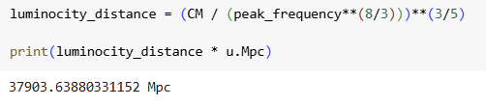
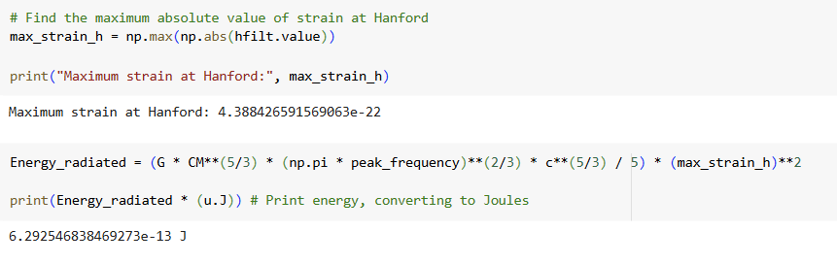
Distance and Energy Lost
We can use the chirp mass, peak frequency and the maximum strain to estimate the distance between the black holes and Earth.
Notice how the distance is very large and the energy lost is so small. This is because my code is wrong.

Slide 7
Conclusion
AI Acknowledgement
Black holes are big. Gravitational waves tell us a lot about the universe, such as how far things can be. Measuring the distance of objects in the universe, combined with redshift data, could also help us get a handle on the age of the universe.
I used AI to generate the peak frequency, frequency derivative, and max strain.

